Slide 1

Managed Security in the Power Platform: Advanced Protection for an AI-Driven World
Juan Carlos González
Microsoft 365 & Microsoft Teams MVP
Notes:
Managed Security in the Power Platform: Advanced Protection for an AI-Driven World

Slide 2





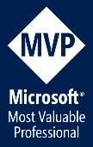


@jcgm1978
jcgonzalezmartin1978@hotmail.com
https://nl.linkedin.com/in/juagon
https://jcgonzalezmartin.wordpress.com/
https://www.youtube.com/@jcgonzalezmartin

Slide 4
Agenda
Protecting data and platforms is a must
Security Layers & Managed Security in the Power Platform
Identity & Access Management + Network Security
Data Access Management, Data Security and Data Loss Prevention
Notes:
Protecting data and platforms is a must
Security layers & Managed Security in the Power Platform
Identity & Access Management + Network Security
Data Access Management, Data Security and Data Loss Prevention
Compliance Standards and Regulations

Slide 5


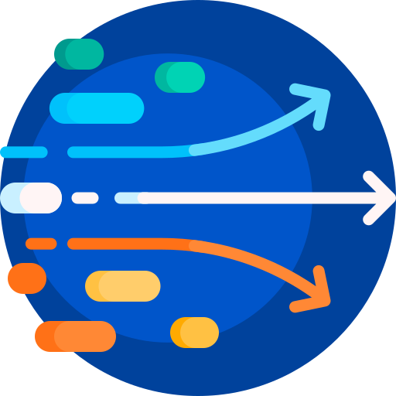

Data Protection Landscape is constantly changing
Growing sophistication of attacks
Explosion of AI scenarios requires a correct and secure access to data
Data access demands from an increasingly dynamic workforce
Regulatory and legal requirements are constantly evolving
Notes:
Growing sophistication of attacks
Drive to leverage data to unlock AI-driven scenarios
Data access demands from an increasingly dynamic workforce
Evolving regulatory and legal requirement

Slide 6

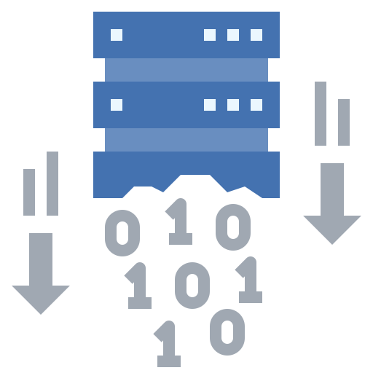




How can I keep Data & Applications secure?
Controlling and limiting access to data
Preventing data exfiltration
Staying compliant with standards and regulations
Protecting data from external threats
Gaining visibility into user activity
Doing risks assessments
Notes:
How can I control and limit access to data?
How can I prevent data exfiltration?
How can I stay compliant with regulations?
How can I protect my data from external threats?
How can I gain visibility into user activity?
How can I assess the risk?

Slide 7


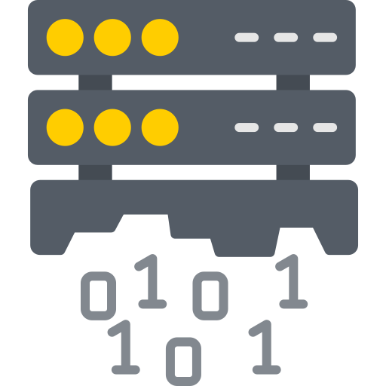

Security Layers in the Power Platform
Identity & Access Management + Network Security
User access management + Data level security
Prevent data exfiltration + Increase visibility
Data encryption and Compliance
Notes:
How can I protect my data from external threats?
Identity management
Network Security
How can I control and limit access to data?
How can I prevent data exfiltration?
How can I gain visibility into user activity?
User access management
Data level security
Prevent data exfiltration
Increased visibility
How can I stay compliant with regulations?
Data encryption
Compliance
How can I assess the risk?

Slide 8
Managed Security in the Power Platform
Advanced protection for an AI-driven world
Security Posture Management
Data Protection
and Privacy
Identity and Access
Management + Network Security
Compliance
Threat Protection
Intelligent guidance for scalable and efficient enterprise-grade security.
Robust controls to ensure confidentiality and encryption, ensuring security of sensitive information.
Seamless and adaptive tools to ensure only authorized resource and data access.
Assured visibility and adherence to industry and regional regulatory requirements.
AI-powered detection and monitoring to address and prevent security risks.
Security guidance
Customer managed keys
IP Firewall
Lockbox
Enforceable solution checker
Data masking
Resource sharing limits
Dataverse audit
Microsoft Sentinel integration
Microsoft Purview Data map integration
IP cookie binding
Data policies (desktop flows)
Privileged Access management
Advanced connector policies
Client app access
Network
Isolation (v-Net)
Conditional Access for Individual Canvas Apps

Slide 9
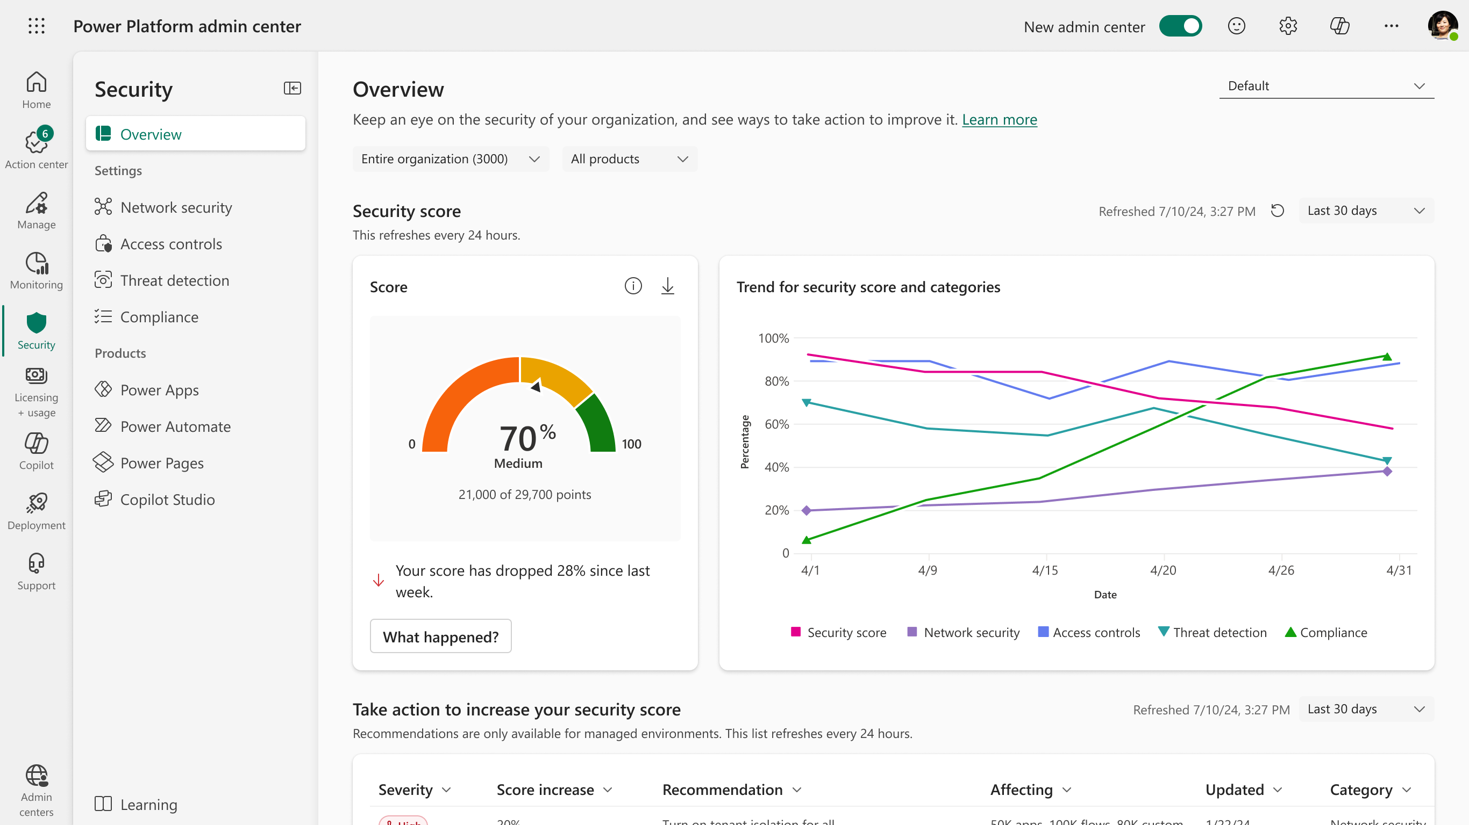
Managed Security in the Power Platform

Slide 10


Demo #1: Power Platform Security Hub

Slide 11




Identity & Access Management
Full support for Microsoft Entra-based identities and access controls
Security groups native integration
Automatically block access if suspicious activities are detected
Make decisions and enforce organization policies regarding user/group membership, IP location, device, risk detection, etc.
Restrict to/from cross tenant connections established via Power Platform Apps and flows
Allow exception through rules based on business needs
Force user re-authentication as response to events such: password change/reset, user account deleted , auth token refresh, MFA enabled, etc
In preview for Dataverse (To enable it, you need to reach Microsoft support)
Authentication
Conditional Access
Tenant Isolation
Continuous Access Evaluation
Notes:
Authentication:
Full support for Microsoft Entra-based identities and access controls
Security group native integration
Automatically block access if suspicious activities are detected
Conditional Access
Make decisions and enforce organization policies regarding user/group membership, IP location, device, risk detection, etc.
Tenant Isolation
Restrict to/from cross tenant connections established via Power Platform applications and flows.
Allow rules based on business needs
Continuous Access Evaluation
Force user re-authentication as response to events such: password change/reset, user account deleted , auth token refresh, MFA enabled, etc.
Current scope: Dataverse, model driven apps

Slide 12
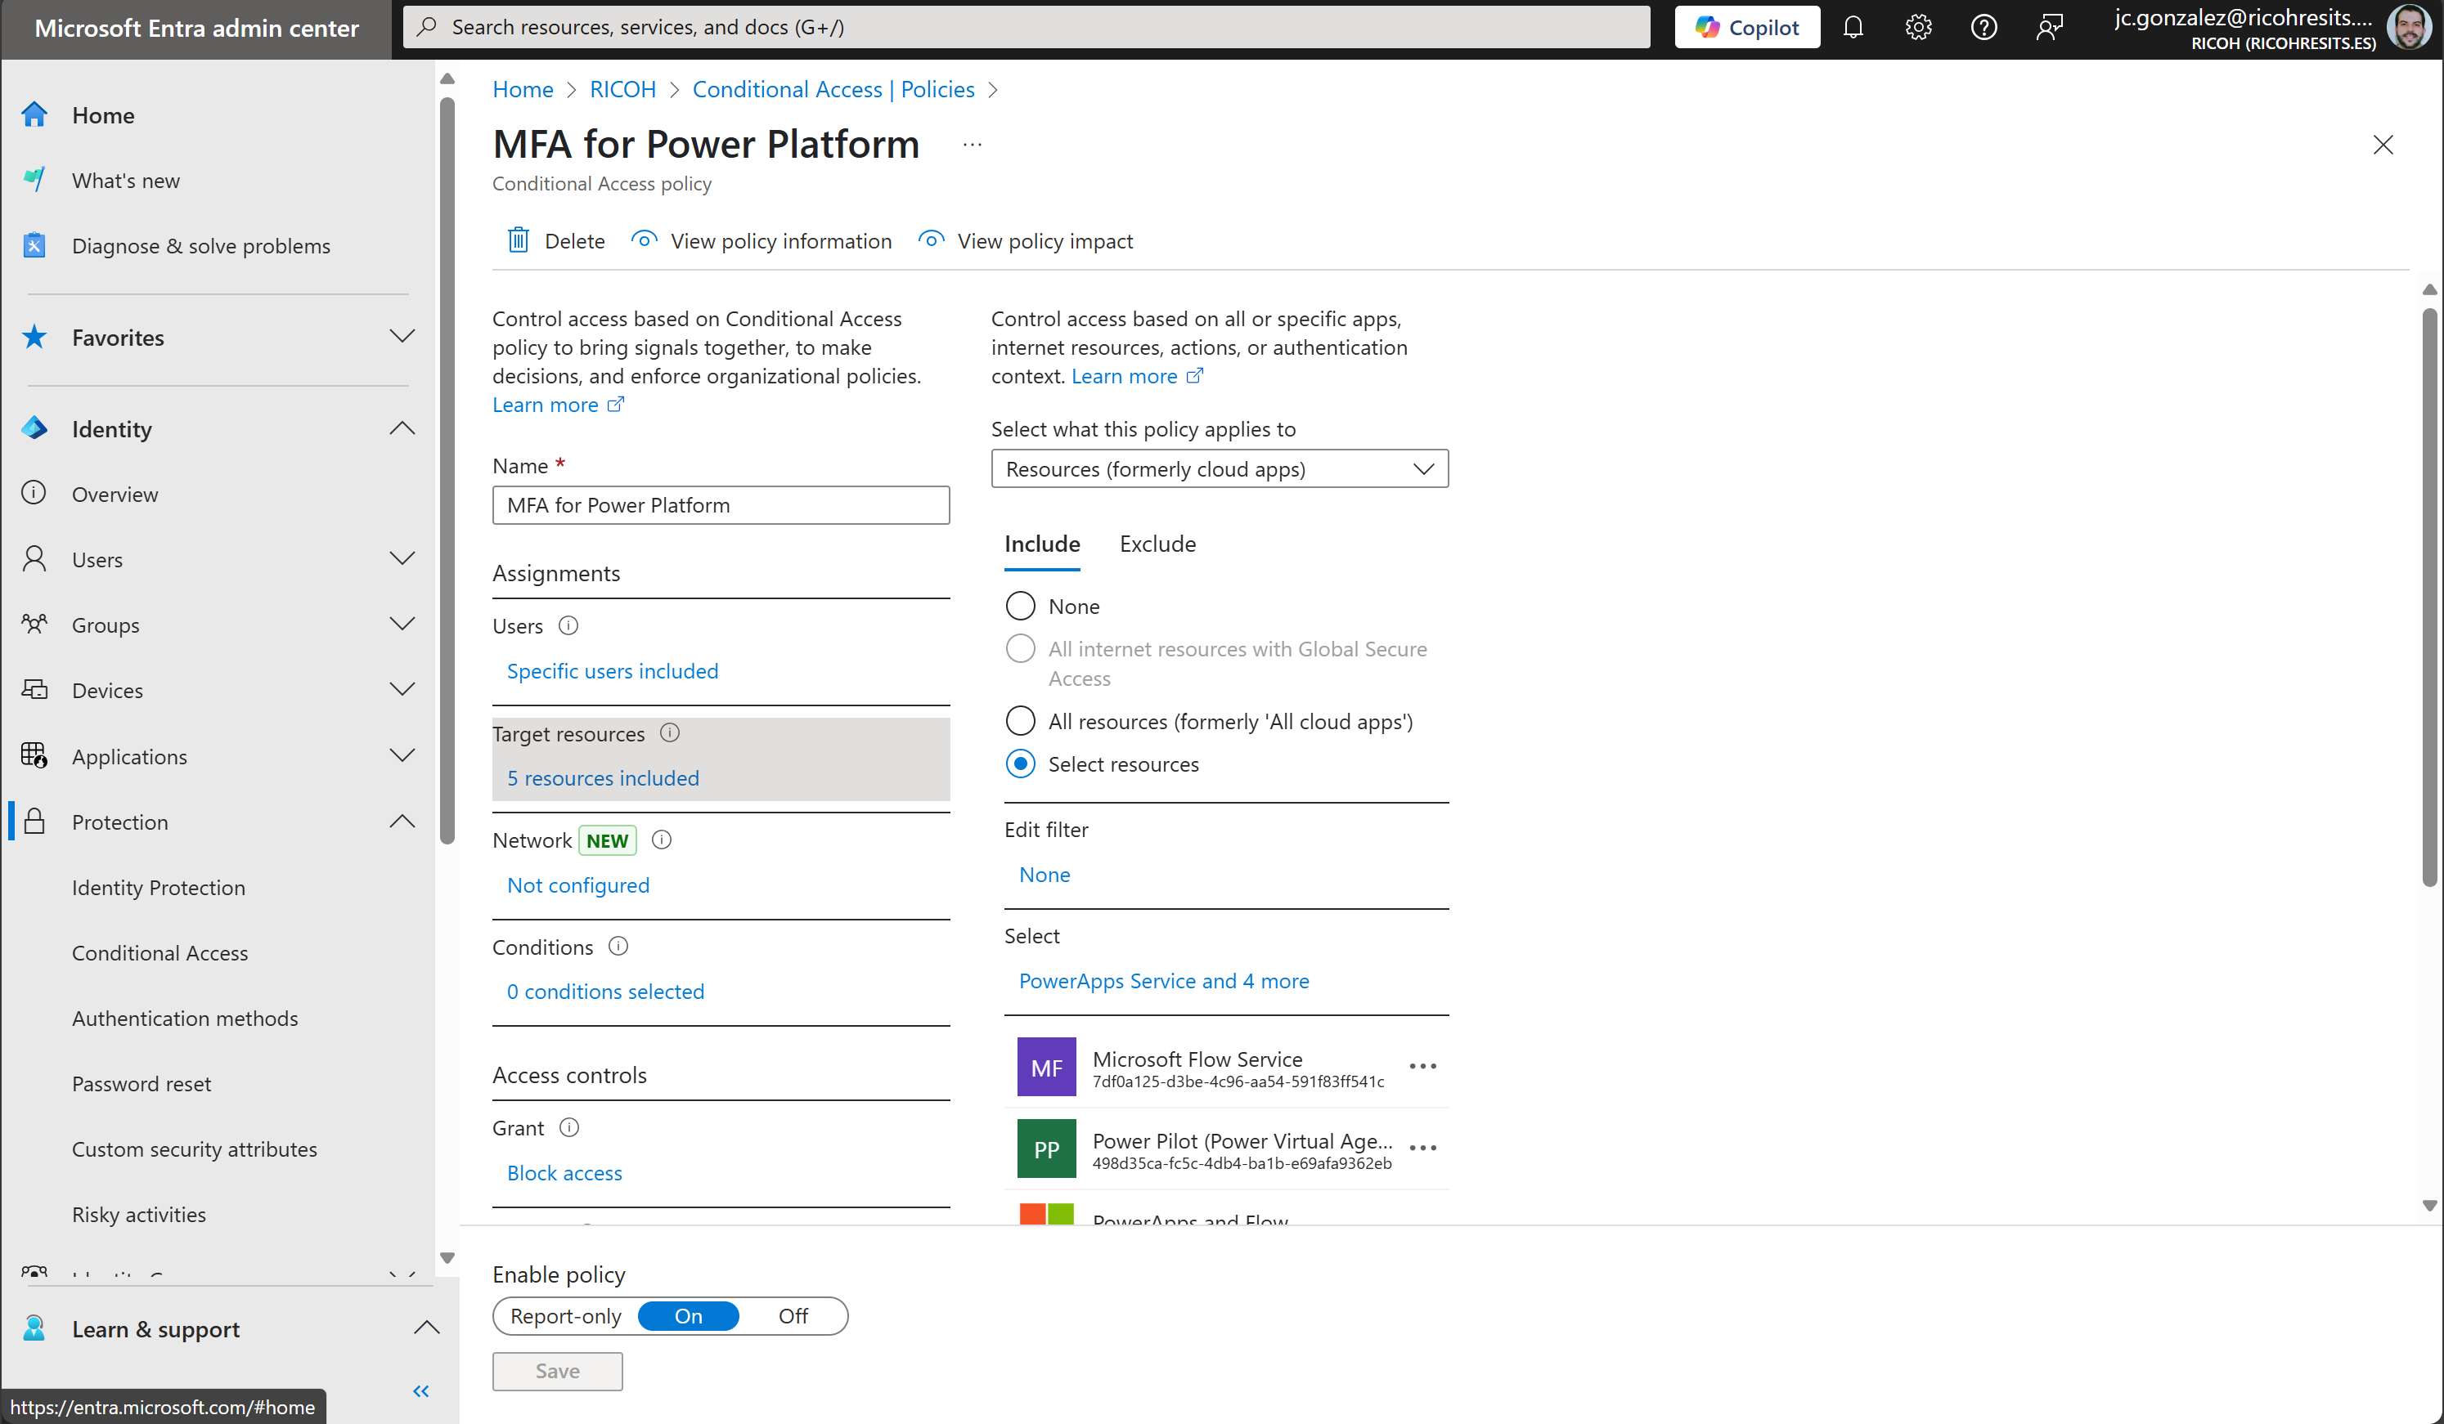
Identity & Access Management – Conditional Access
Conditional Access for the Power Platform

Slide 13
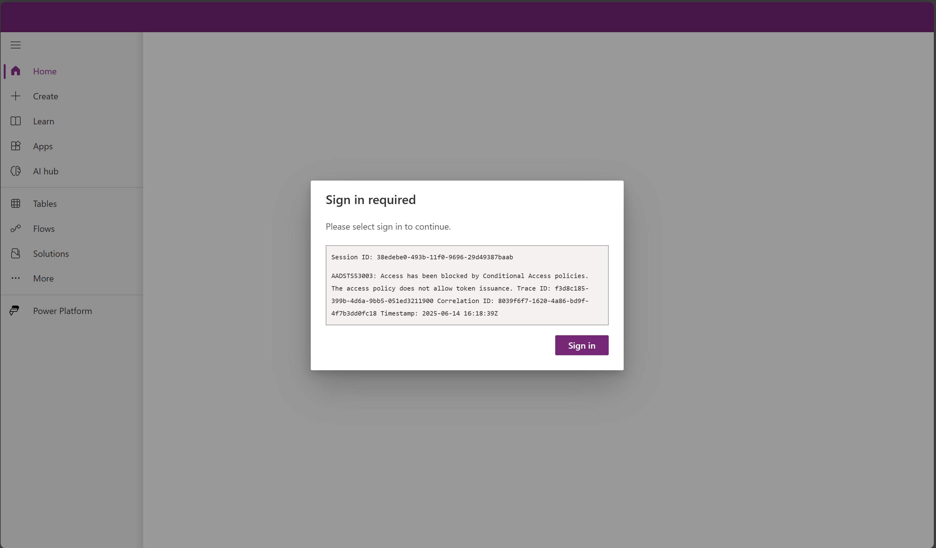
Identity & Access Management – Conditional Access

Slide 14
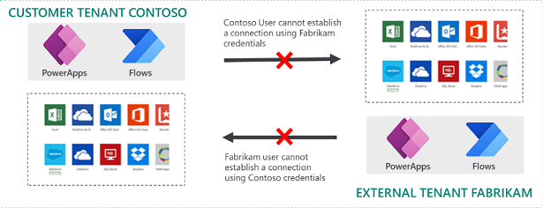
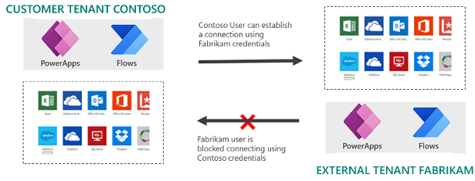
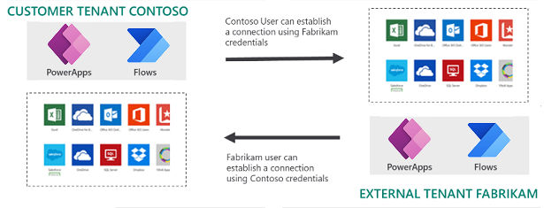
Identity & Access Management – Tenant Isolation: Scenarios
Notes:
Restrict cross-tenant inbound and outbound access - Power Platform | Microsoft Learn

Slide 15
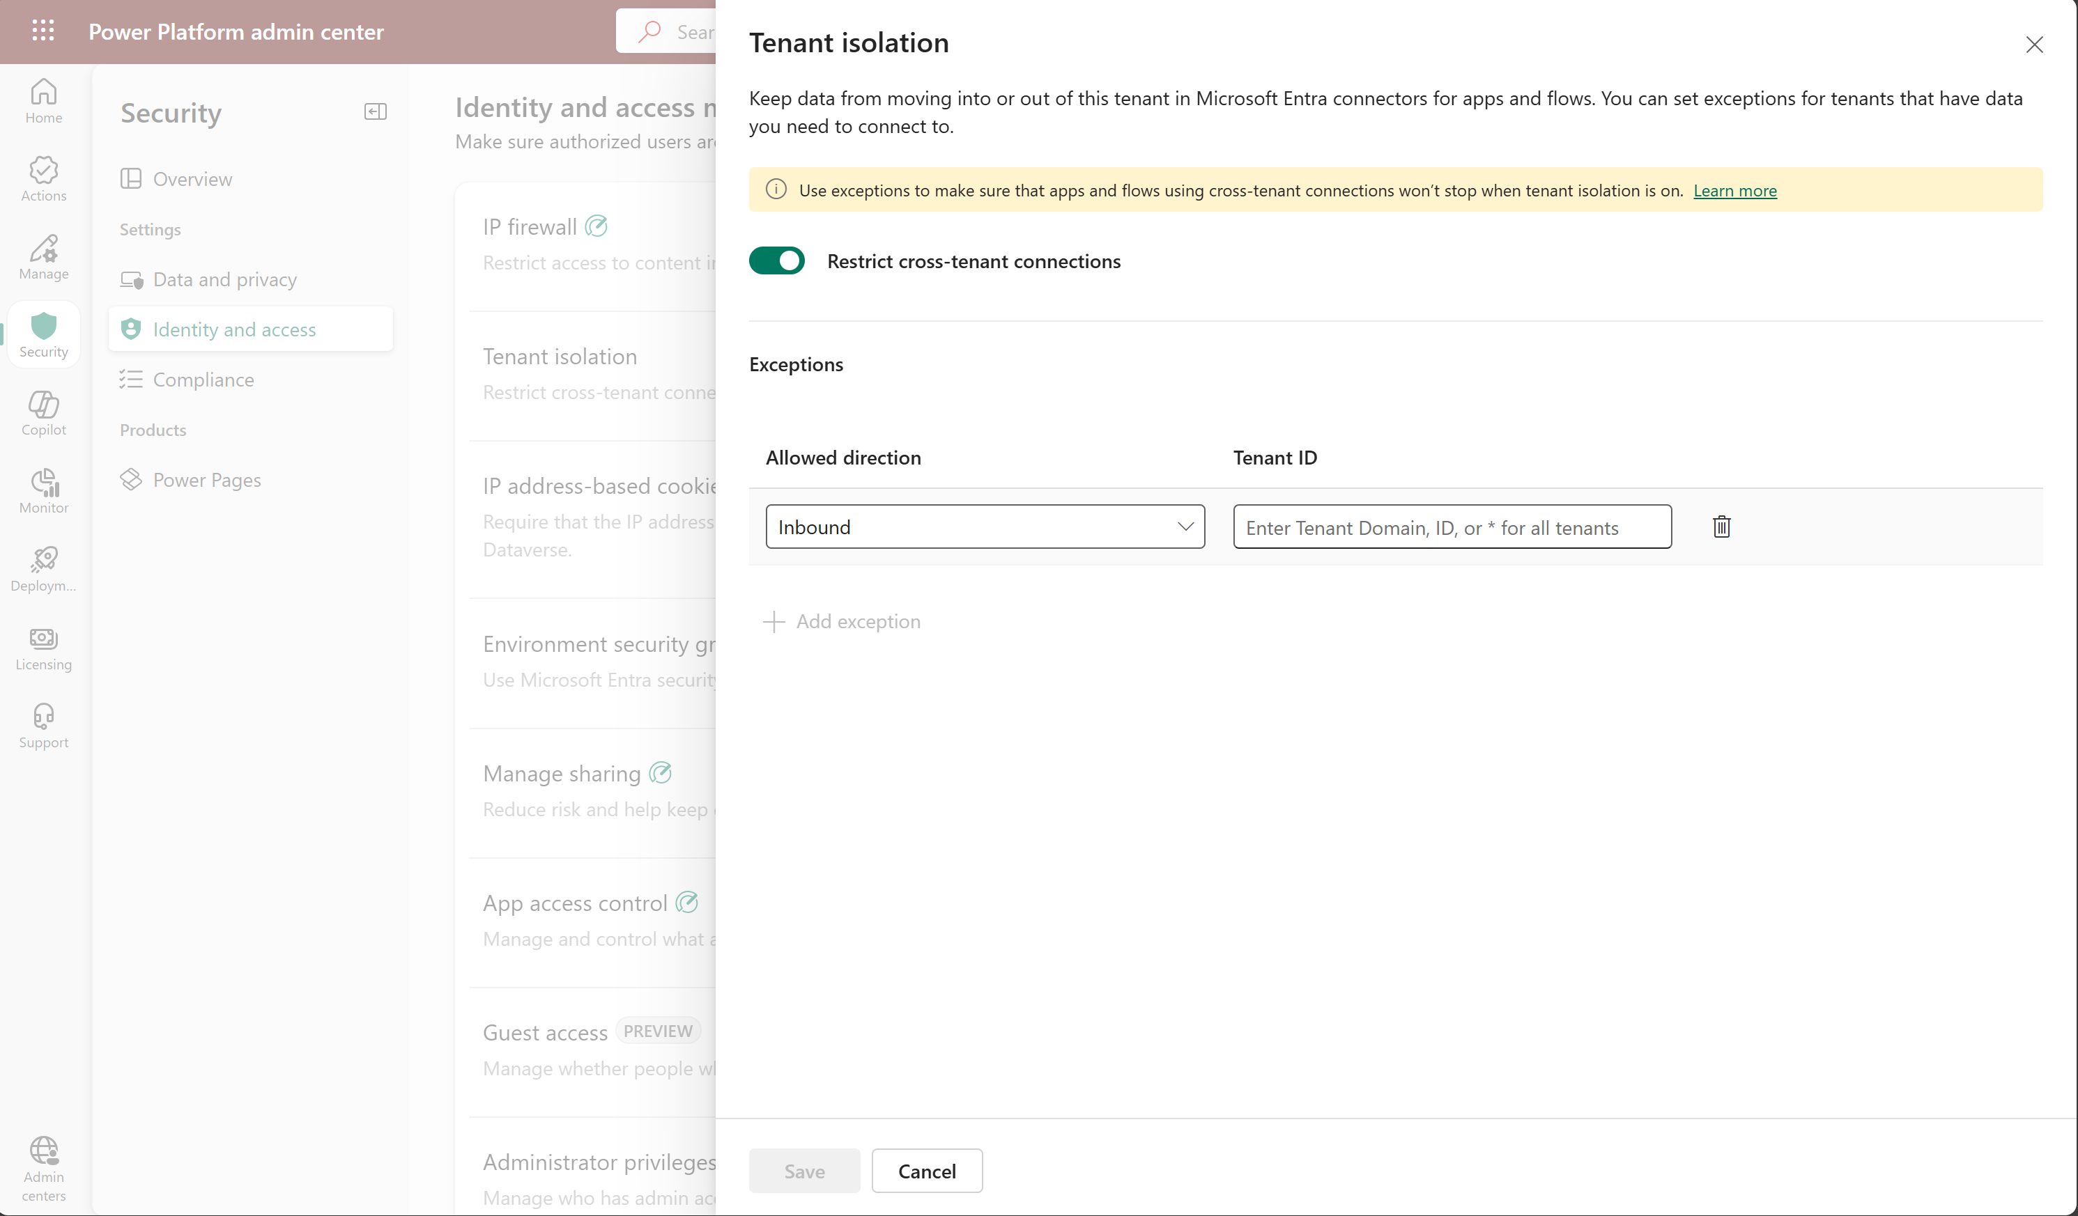
Identity & Access Management – Tenant Isolation Setup
Tenant Isolation enabled in the tenant
2
Identity and access settings
1
Exceptions can be configured in 1 way or 2 ways
3

Slide 16
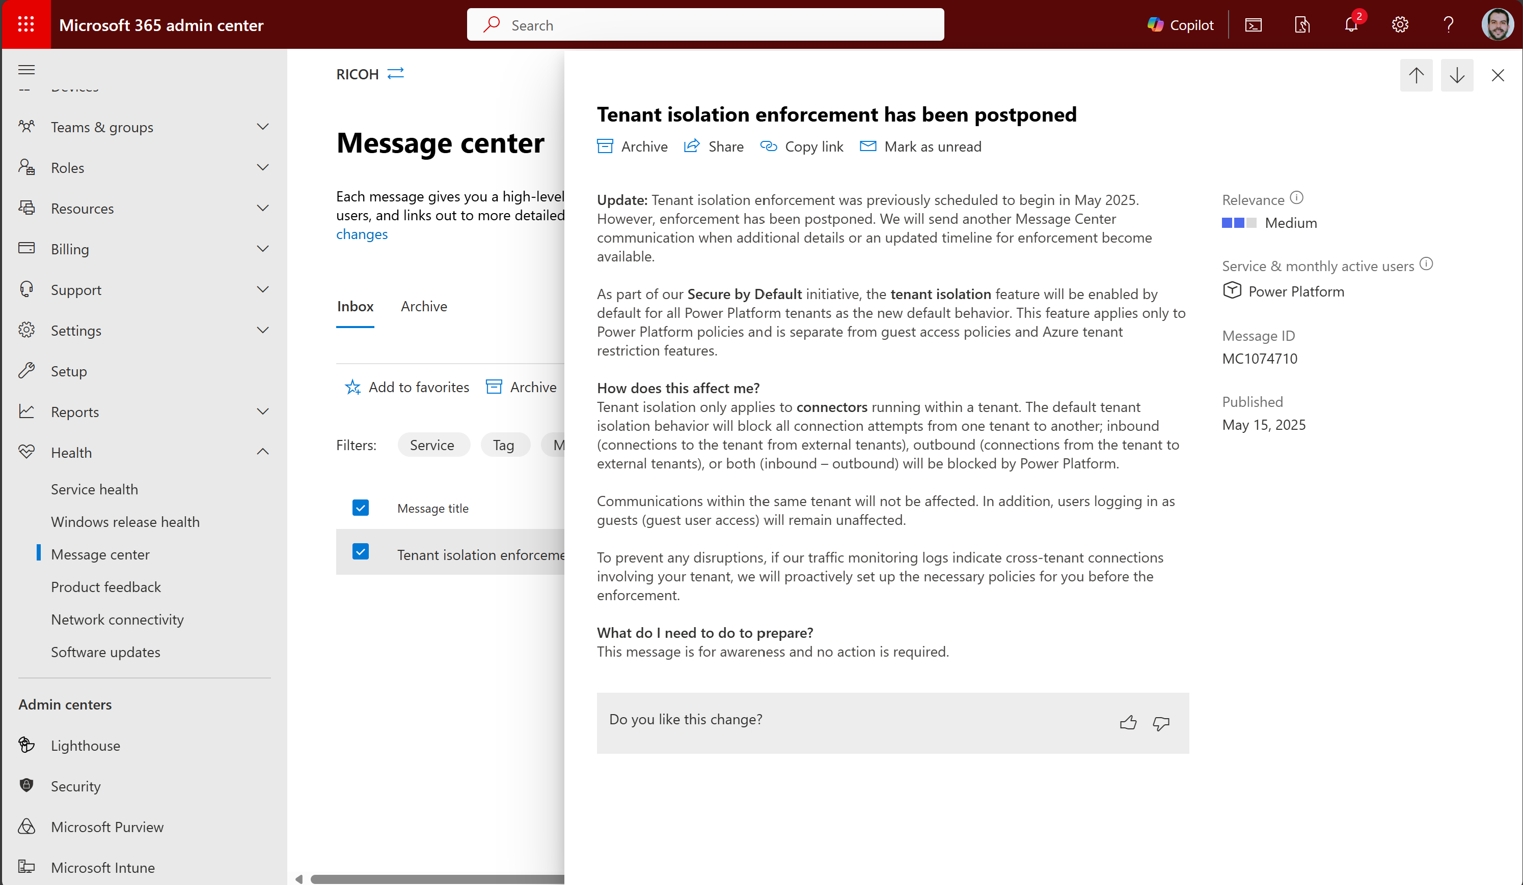
Identity & Access Management – Tenant Isolation Setup
Future state of Tenant Isolation in a tenant

Slide 17
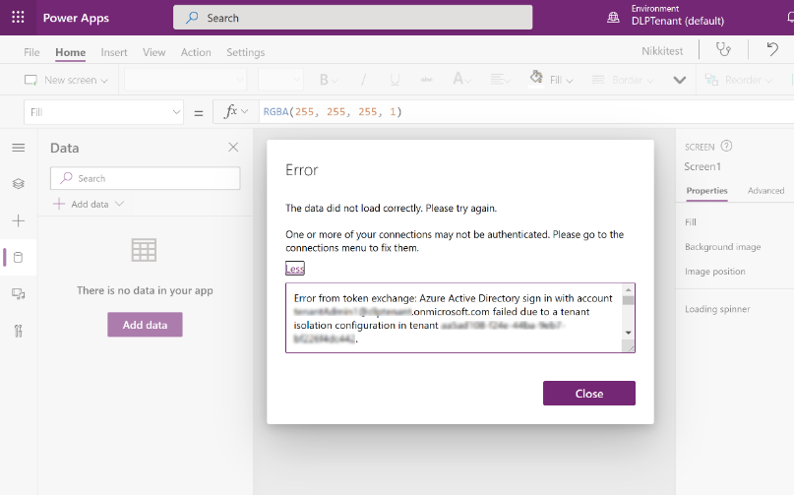
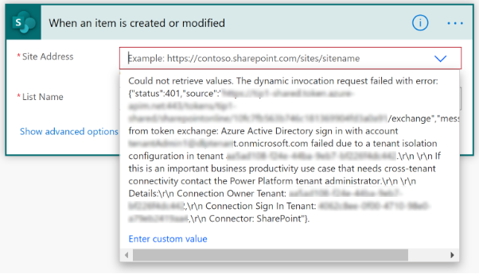
Identity & Access Management – Tenant Isolation
Impact on Apps & Flows:

Slide 18
Demo #2: Conditional Access + Tenant Isolation

Slide 19
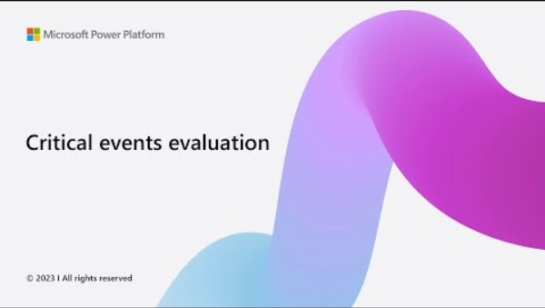
Identity & Access Management – Continuous Access Evaluation

Slide 20






Network Security – The big picture
Azure vNet
Private endpoints
Continuous Access Evaluation
Secure identity
Prevent data exfiltration
Azure Network Watcher
Azure Sentinel
Azure Firewall
Data policies
Secure endpoints
Security compliance
Azure NSG
Azure Policy
IP based cookie binding
Service Endpoints
Secure network
Gain more control
Service Tags
IP firewall
Reverse proxy
Private DNS zones
Inbound connectivity
Outbound connectivity

Slide 21



Network Security
Filter inbound and outbound traffic
Use in network access controls on Network Security Groups (NSGs) or Azure Firewall instead of approved IP ranges
Minimize the complexity of frequent updates to network security rules
Prevents malicious users, outside allowed IP ranges, from accessing your data
Mitigate insider threats like data exfiltration + Prevent token replay attacks
Current Scope: Dataverse (Managed Environments, Environment Groups, OData EndPoints)
Approved host names & IP ranges
Service tags
IP Firewall
Notes:
Approved host names & IP ranges
Filter inbound and outbound traffic
Service tags
Use in network access controls on Network Security Groups (NSGs) or Azure Firewall instead of approved IP ranges
Minimize the complexity of frequent updates to network security rules
IP Firewall IP firewall in Power Platform environments - Power Platform | Microsoft Learn
Prevents malicious users, outside allowed IP ranges, from accessing your data –
Mitigate insider threats like data exfiltration: A malicious user who tries to download data from Dataverse using a client tool like Excel or Power BI from a disallowed IP location is blocked from doing so in real time.
Prevent token replay attacks: If a user steals an access token and tries to use it to access Dataverse from outside allowed IP ranges, Dataverse denies the attempt in real time.
Current scope: Dataverse
IP Cookie Binding Safeguarding Dataverse sessions with IP cookie binding - Power Platform | Microsoft Learn
Prevents attackers using cookies to impersonate an authorized user
Current scope: Dataverse
Network Isolation Virtual Network support overview - Power Platform | Microsoft Learn
Helps you route all network traffic from Power Platform environments to your v-Net without routing through internet.
Scope supported: Dataverse plugins, selected connectors

Slide 22


Network Security
Prevents attackers using cookies to impersonate an authorized user
Current Scope: Dataverse (Managed Environments)
Helps to route all network traffic from Power Platform environments to Azure v-Nets without routing through the Internet
Scope supported: Dataverse plugins, selected connectors
IP Cookie Binding
Network Isolation
Notes:
Approved host names & IP ranges
Filter inbound and outbound traffic
Service tags
Use in network access controls on Network Security Groups (NSGs) or Azure Firewall instead of approved IP ranges
Minimize the complexity of frequent updates to network security rules
IP Firewall IP firewall in Power Platform environments - Power Platform | Microsoft Learn
Prevents malicious users, outside allowed IP ranges, from accessing your data –
Mitigate insider threats like data exfiltration: A malicious user who tries to download data from Dataverse using a client tool like Excel or Power BI from a disallowed IP location is blocked from doing so in real time.
Prevent token replay attacks: If a user steals an access token and tries to use it to access Dataverse from outside allowed IP ranges, Dataverse denies the attempt in real time.
Current scope: Dataverse
IP Cookie Binding Safeguarding Dataverse sessions with IP cookie binding - Power Platform | Microsoft Learn
Prevents attackers using cookies to impersonate an authorized user
Current scope: Dataverse
Network Isolation Virtual Network support overview - Power Platform | Microsoft Learn
Helps you route all network traffic from Power Platform environments to your v-Net without routing through internet.
Scope supported: Dataverse plugins, selected connectors

Slide 23
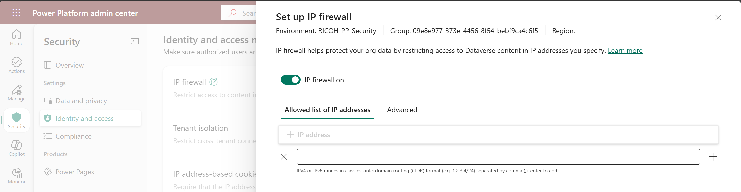
Network Security – IP Firewall for an Environment
IP Firewall
2
IP Firewall enabled for the environment
3
Identity & Access Management
1
IP address or IP addresses range
4

Slide 24
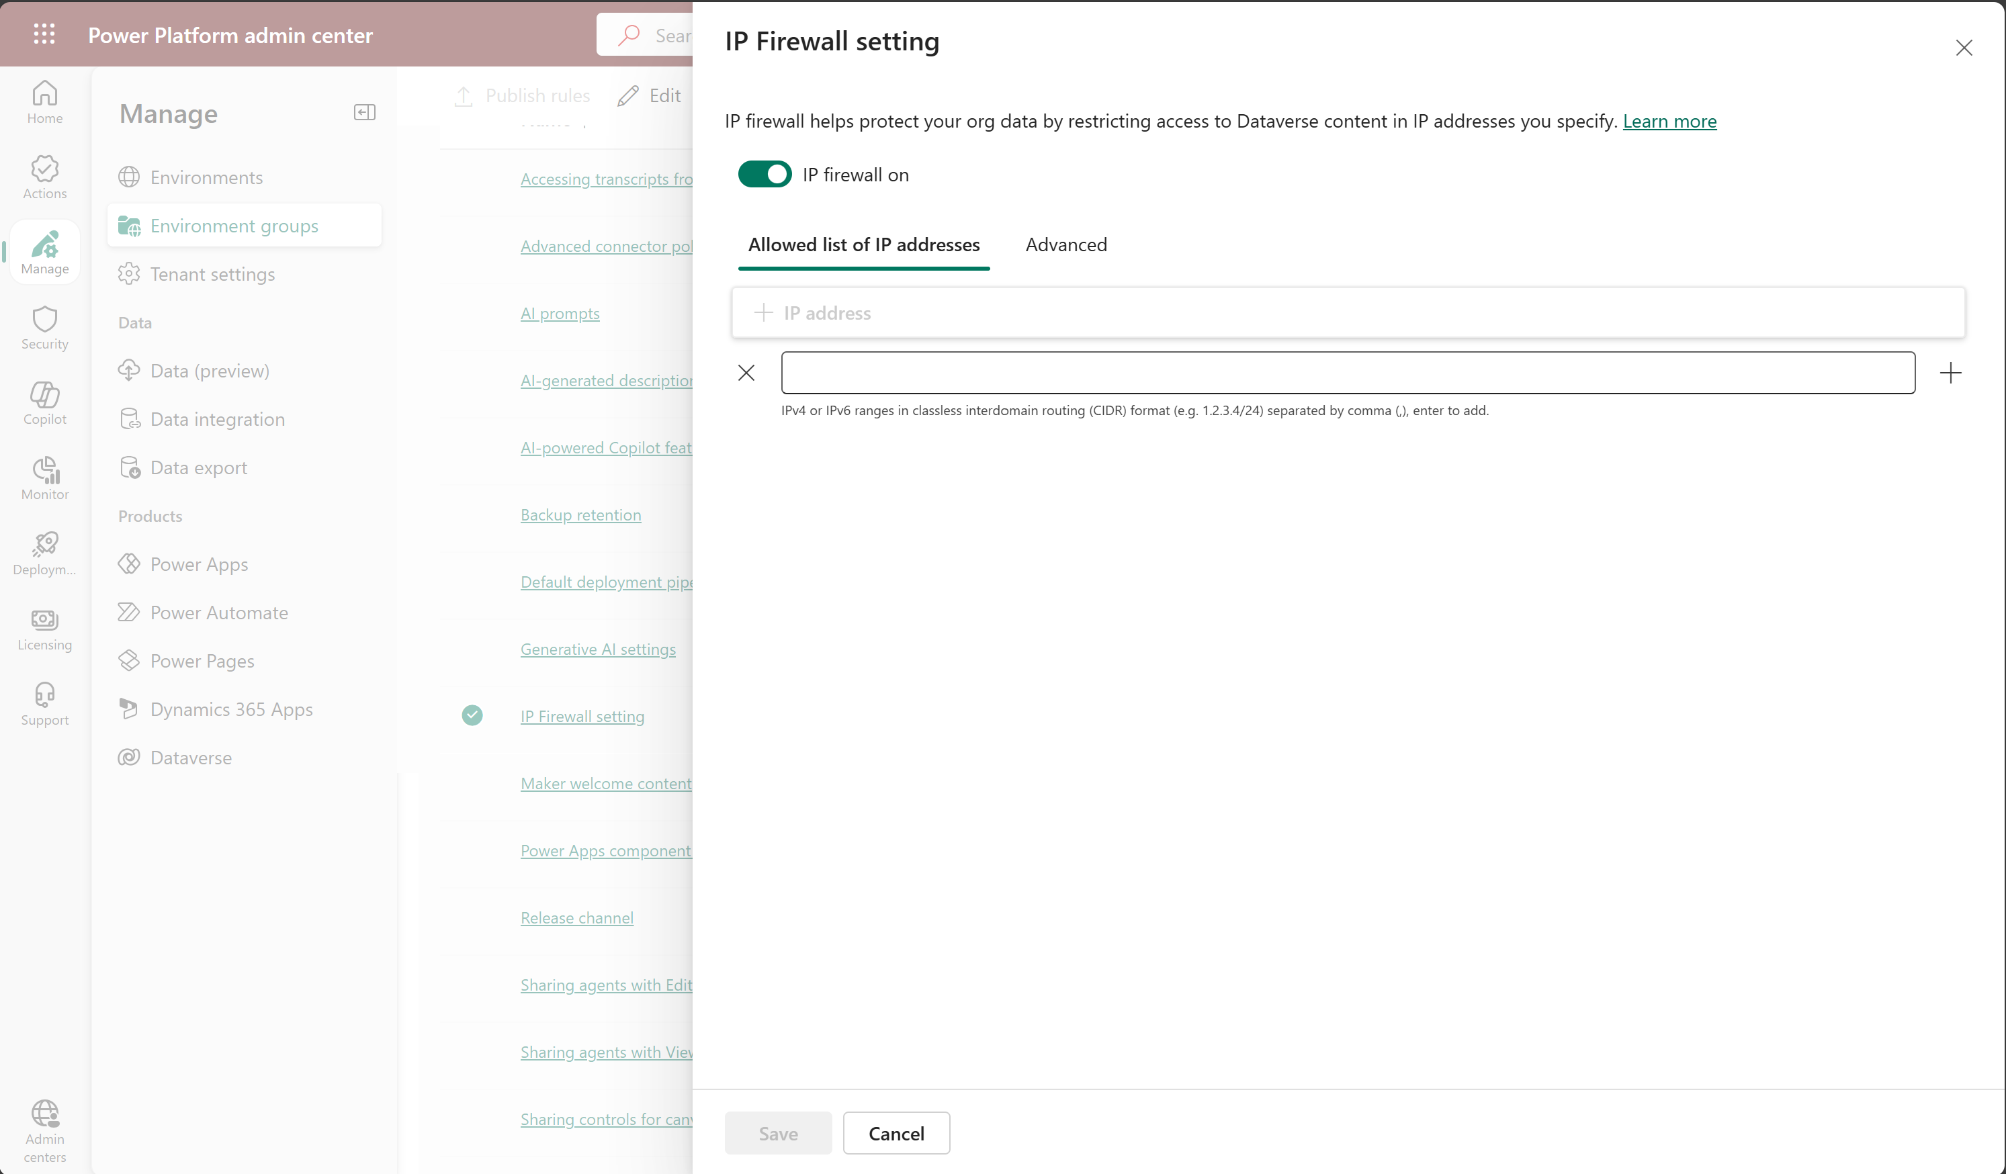
Network Security – IP Firewall for Environment Groups
Enable IP Firewall for the Env. Group
2
IP address or IP addresses range
3
IP Firewall settings for the Env. Group
1

Slide 25
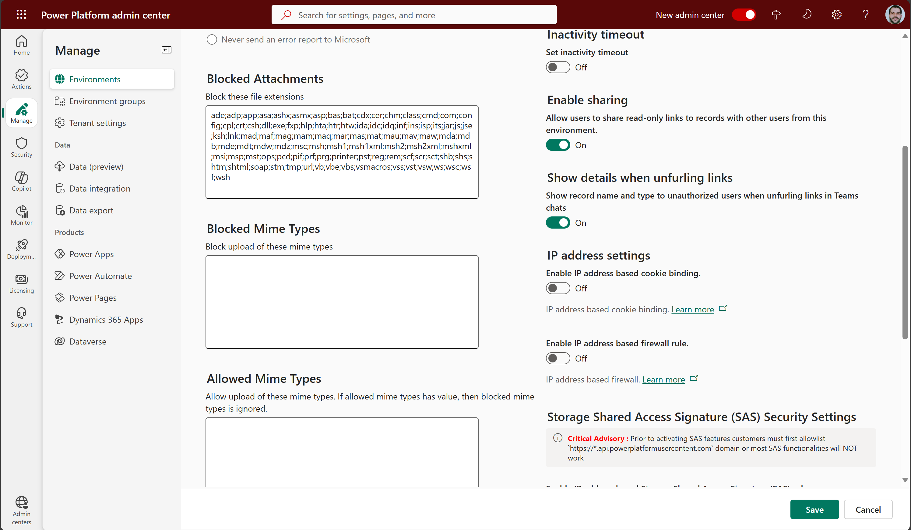
Network Security – IP Cookie Binding for an Environment
IP cookie binding setting

Slide 26
Demo #3: Network Security

Slide 27
Identity & Access Management + Nework Security: Key Learnings
Take advantage of Microsoft Entra identities native integration
Configure Conditional Access policies for Power Apps, Power Automate, Power BI and even Copilot Studio
Evaluate if you need to enable tenant isolation
Restrict traffic to Power Platform resources to a specified IP range (Managed environments, up to 200 IP address)
Limit the endpoints Power Platform resources can connect to with connection endpoint filtering
Prevent cookie replay attacks with IP based cookie binding
Use Azure vNet to enforce traffic to travel through your virtual private network, without the need to configure on-premises data gateway

Slide 28




Data Access Management for Apps & Users
Only licensed users with a valid Microsoft Entra ID can log into the system
A PP environment is the security boundary and the unit of governance management
Best practice: assign security groups to environments to manage user access
Access as owner/co-owner: Edit/Share/Use
Access to run components – use only no edit
Prevents malicious users from using unapproved apps to export sensitive data
Allows to control which Apps can run in a Dataverse environment
Tenant Access
Environment Access
Resources Access
App Access Control
Notes:
Tenant Access
Only licensed users with a valid Microsoft Entra ID can log into the system.
Environment Access
Environment is the security boundary and the unit of governance management
Recommended to assign security groups to environments to manage user access
Resources Access:
Access to co-own components – edit, share, use
Access to run components – use only no edit
App Access Control
Protect against data exfiltration by controlling which apps can run in your Dataverse environment. These safeguards prevent unauthorized removal of sensitive information, helping your business maintain continuity and comply with regulations.
Configure which apps are allowed or blocked in your environment. This prevents malicious users from using unapproved apps to export sensitive data.

Slide 29
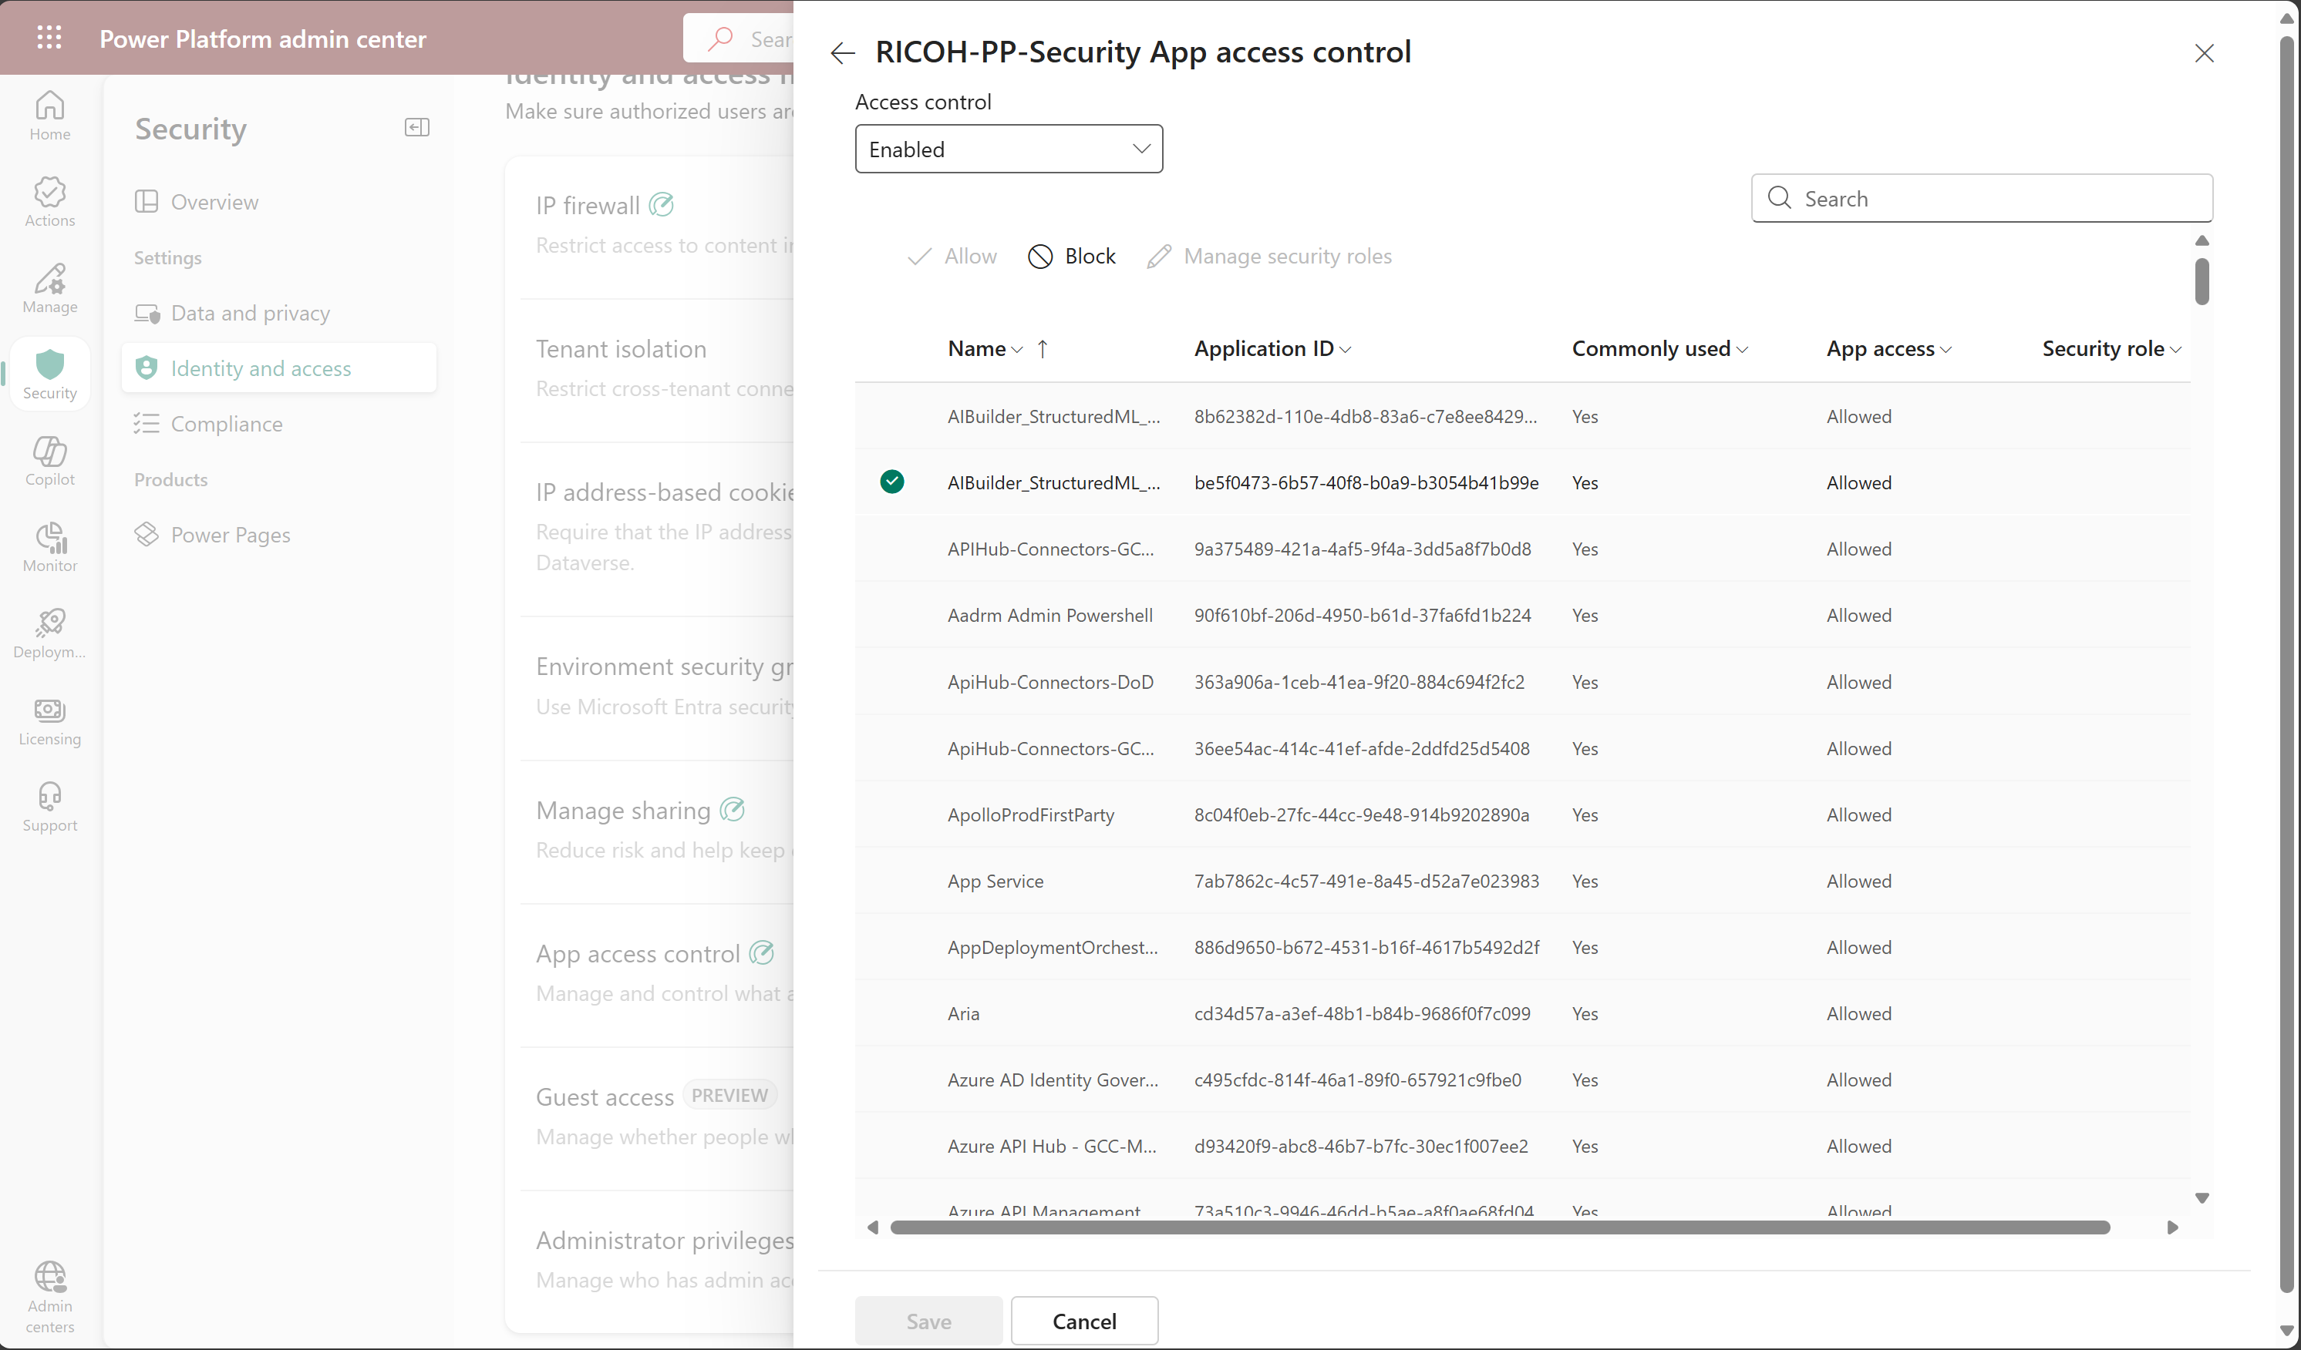
Data Access Management for Apps: Disabling App Access to an environment
Identity & Access Settings
Block / Allow Apps access to the environment
3
1
App access control setting
2
Notes:
Tenant Access
Only licensed users with a valid Microsoft Entra ID can log into the system.
Environment Access
Environment is the security boundary and the unit of governance management
Recommended to assign security groups to environments to manage user access
Resources Access:
Access to co-own components – edit, share, use
Access to run components – use only no edit
App Access Control
Protect against data exfiltration by controlling which apps can run in your Dataverse environment. These safeguards prevent unauthorized removal of sensitive information, helping your business maintain continuity and comply with regulations.
Configure which apps are allowed or blocked in your environment. This prevents malicious users from using unapproved apps to export sensitive data.

Slide 30
Data Access Management by User Type: Some Tips & Recommendations
Secure the default environment
Define an environment strategy
Limit sharing with everyone: configure specific limits at the environment level (managed environments)
Define data policies
Govern custom connectors usage
Enable tenant isolation
Route makers to dedicated environments
Everyone includes all users in Entra ID, including guests
Guests are treated as any other users in the tenant
Confirm if guests making apps in your organization is required. Disable if guests are not expected to be makers
Disable guest access to Power Platform resources using Conditional Access
Disable share with everyone (Global vs. Managed Environments)
Control access using roles and permissions
Govern administrator roles assignment to guests
Govern Maker Access
Govern Guest Access
Notes:
Tenant Access
Only licensed users with a valid Microsoft Entra ID can log into the system.
Environment Access
Environment is the security boundary and the unit of governance management
Recommended to assign security groups to environments to manage user access
Resources Access:
Access to co-own components – edit, share, use
Access to run components – use only no edit
App Access Control
Protect against data exfiltration by controlling which apps can run in your Dataverse environment. These safeguards prevent unauthorized removal of sensitive information, helping your business maintain continuity and comply with regulations.
Configure which apps are allowed or blocked in your environment. This prevents malicious users from using unapproved apps to export sensitive data.

Slide 31
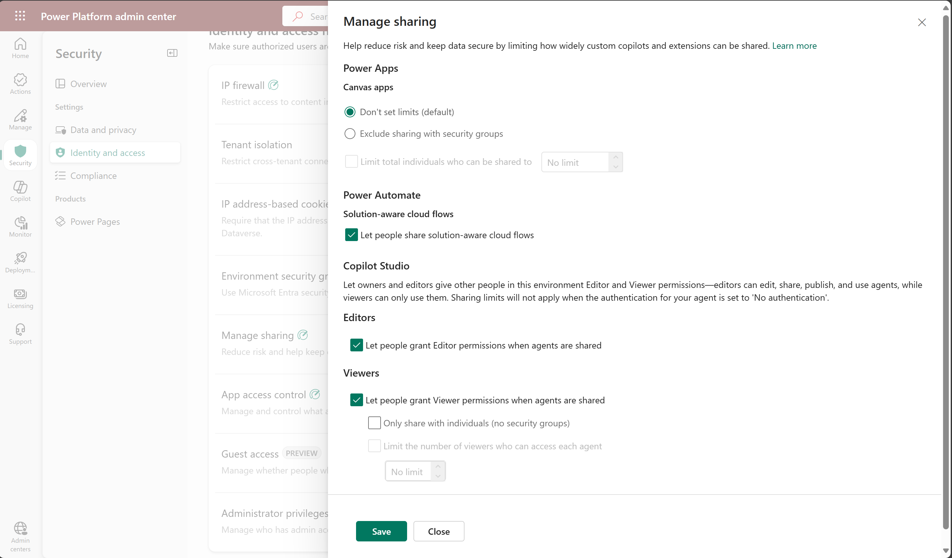
Data Access Management by User Type: Sharing Settings for an Environment
Canvas Apps Sharing settings
3
Identity & Access Settings
Power Automate Sharing settings
4
1
Copilot Studio Sharing settings
5
Manage sharing setting
2
Notes:
Tenant Access
Only licensed users with a valid Microsoft Entra ID can log into the system.
Environment Access
Environment is the security boundary and the unit of governance management
Recommended to assign security groups to environments to manage user access
Resources Access:
Access to co-own components – edit, share, use
Access to run components – use only no edit
App Access Control
Protect against data exfiltration by controlling which apps can run in your Dataverse environment. These safeguards prevent unauthorized removal of sensitive information, helping your business maintain continuity and comply with regulations.
Configure which apps are allowed or blocked in your environment. This prevents malicious users from using unapproved apps to export sensitive data.

Slide 32
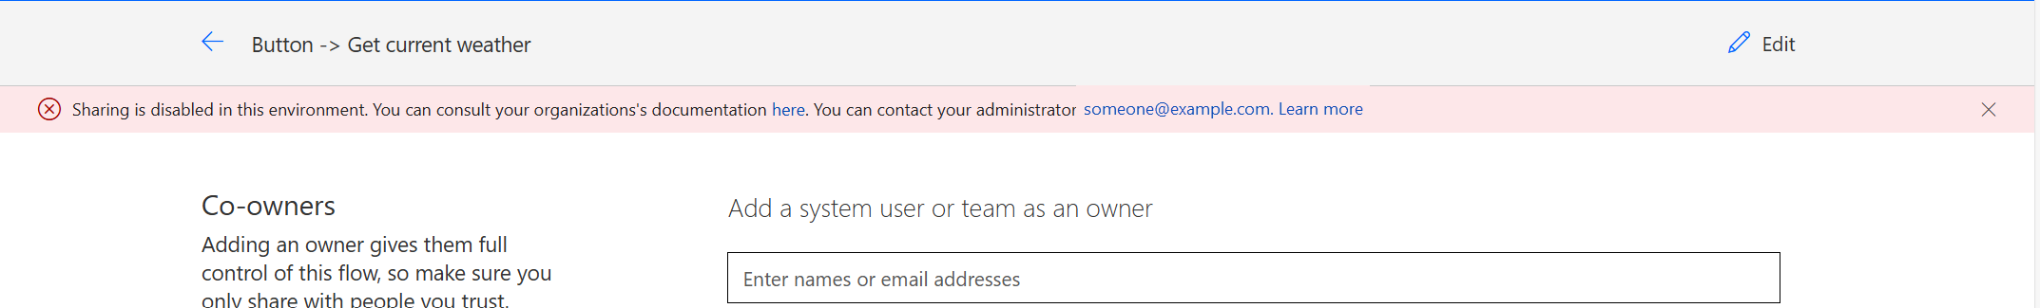
Data Access Management by User Type: Sharing Settings for an Environment
Notes:
Tenant Access
Only licensed users with a valid Microsoft Entra ID can log into the system.
Environment Access
Environment is the security boundary and the unit of governance management
Recommended to assign security groups to environments to manage user access
Resources Access:
Access to co-own components – edit, share, use
Access to run components – use only no edit
App Access Control
Protect against data exfiltration by controlling which apps can run in your Dataverse environment. These safeguards prevent unauthorized removal of sensitive information, helping your business maintain continuity and comply with regulations.
Configure which apps are allowed or blocked in your environment. This prevents malicious users from using unapproved apps to export sensitive data.

Slide 33
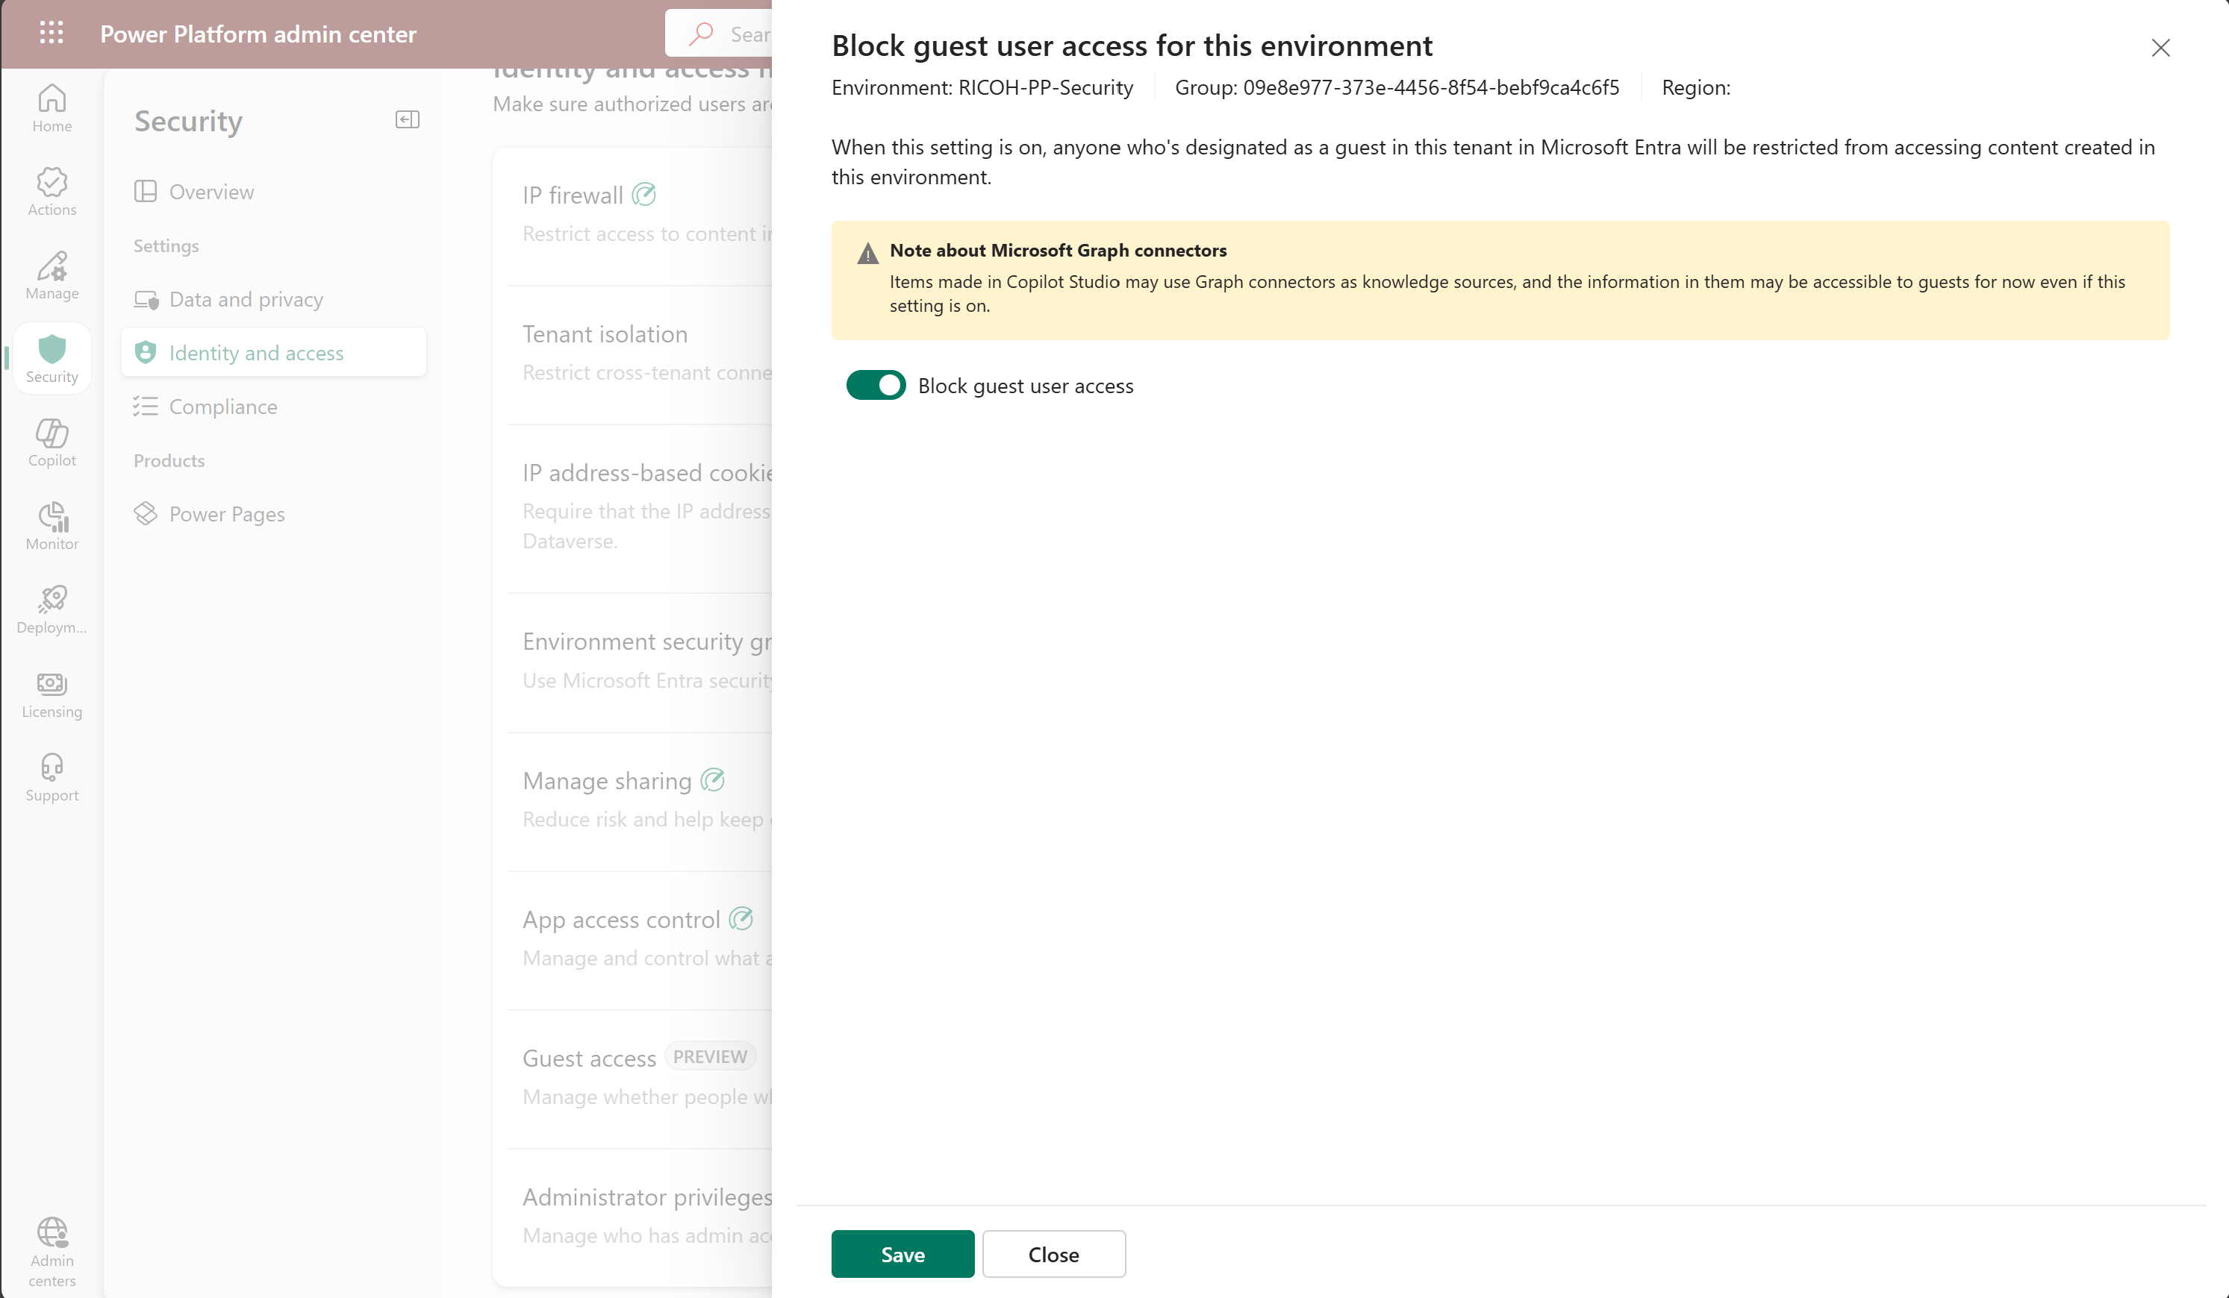
Data Access Management by User Type: Guests Access Settings for an Environment
Enable/Disable Guest access for the environment
Identity & Access Settings
3
1
Guest access setting
2
Notes:
Tenant Access
Only licensed users with a valid Microsoft Entra ID can log into the system.
Environment Access
Environment is the security boundary and the unit of governance management
Recommended to assign security groups to environments to manage user access
Resources Access:
Access to co-own components – edit, share, use
Access to run components – use only no edit
App Access Control
Protect against data exfiltration by controlling which apps can run in your Dataverse environment. These safeguards prevent unauthorized removal of sensitive information, helping your business maintain continuity and comply with regulations.
Configure which apps are allowed or blocked in your environment. This prevents malicious users from using unapproved apps to export sensitive data.

Slide 34
Data Access Management by User Type: Some Tips & Recommendations
Implement security access using a layered approach (App | Form | Record | Field)
Use explicit authentication for shared connections
Cleanup of deleted users/reassign owned records
Licensing is not a security control
Review Sharing limits
Make use of Microsoft Entra security groups
User access diagnostics and troubleshooting
Limit Power Platform administrator roles
Enable Power Platform Admin roles through Privileged Identity Management:
Enforce on-demand, just-in-time administrative access when needed
Minimize number of privileged users (admins) and duration of access
Reduce risks of authorized user impact on sensitive data
Reduce risks of malicious user getting access
Be aware of current limitations in regards of adding/removing the System Administrator Role
Govern User Access
Govern Admin Access
Notes:
Tenant Access
Only licensed users with a valid Microsoft Entra ID can log into the system.
Environment Access
Environment is the security boundary and the unit of governance management
Recommended to assign security groups to environments to manage user access
Resources Access:
Access to co-own components – edit, share, use
Access to run components – use only no edit
App Access Control
Protect against data exfiltration by controlling which apps can run in your Dataverse environment. These safeguards prevent unauthorized removal of sensitive information, helping your business maintain continuity and comply with regulations.
Configure which apps are allowed or blocked in your environment. This prevents malicious users from using unapproved apps to export sensitive data.

Slide 35
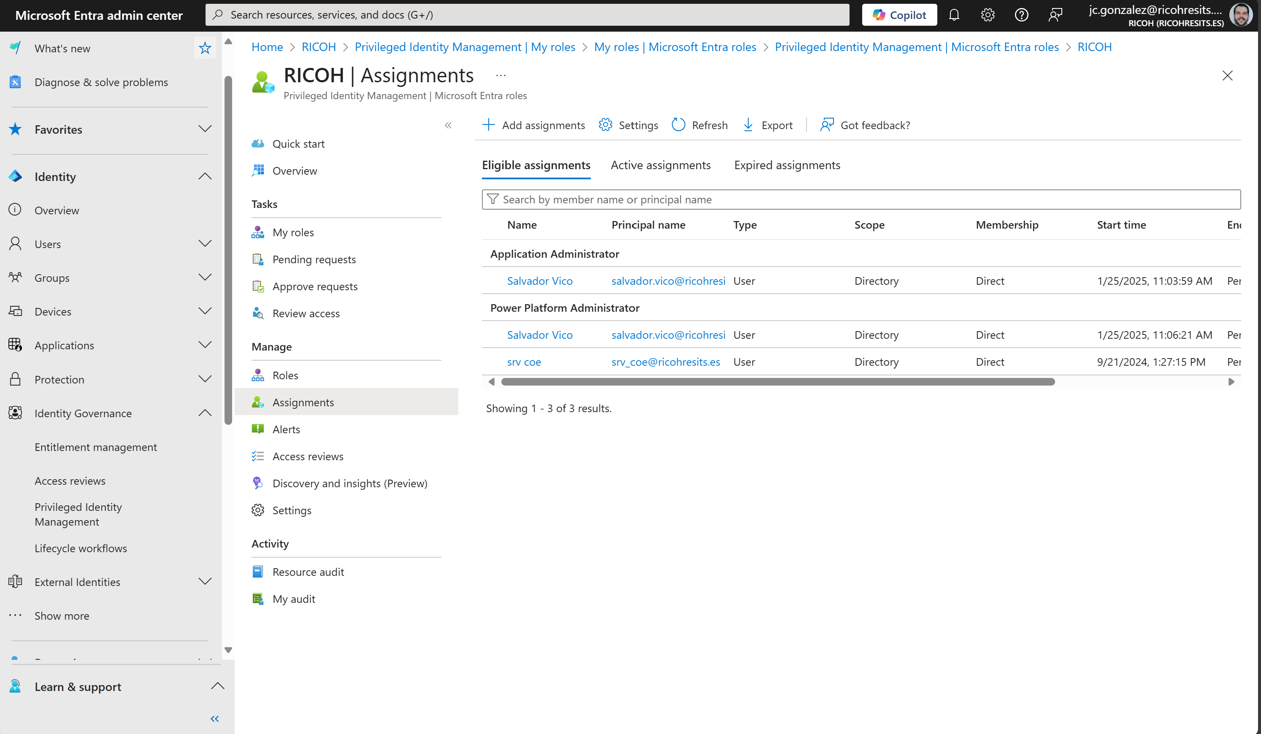
Data Access Management by User Type: Privilege Identity Management
Eligible Power Platform Admin Role assignment
Be aware of the limitations of using PIM with the PP Admin role
Notes:
Tenant Access
Only licensed users with a valid Microsoft Entra ID can log into the system.
Environment Access
Environment is the security boundary and the unit of governance management
Recommended to assign security groups to environments to manage user access
Resources Access:
Access to co-own components – edit, share, use
Access to run components – use only no edit
App Access Control
Protect against data exfiltration by controlling which apps can run in your Dataverse environment. These safeguards prevent unauthorized removal of sensitive information, helping your business maintain continuity and comply with regulations.
Configure which apps are allowed or blocked in your environment. This prevents malicious users from using unapproved apps to export sensitive data.

Slide 36
Demo #4: Data Access Security
Notes:
Guest Users access setup
App Data Access (Preview)
PIM

Slide 37
Data Access Security: Key Learnings
Secure Your Power Platform Deployment best practices
Limit sharing to business users that need to access the app
Licensing is not a security control
Route makers to dedicated developer environments
Assign security groups to environments
Configure solution checker to automate analysis against best practices rules and identify solution issues
Educate makers regarding organization’s best practices with maker welcome content
Assign administrator roles judiciously and enable them just in time

Slide 38


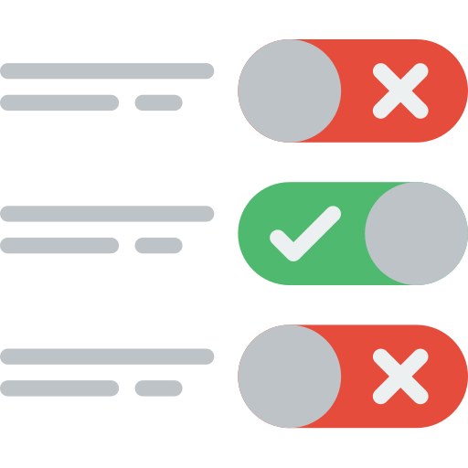

Data Protection – Data Policies
Prevent makers to expose corporate Information
2 levels of Application: Tenant-Wide vs. Environment
Prevent makers from building apps and flows that leverage blocked connectors
Extended Data Policies to support prevent creating new connections to blocked connectors
Providing admins fine grain control over which actions within a connector are permitted within the environment
Users consents to specific permissions required to establish connections to data sources.
Accurate and concise description of what the connector will be executing prior to connection creation specific to actions executed in the application
Data Policies
Data Policies in Design Time
Connector Action Control
User Granular Consent

Slide 39
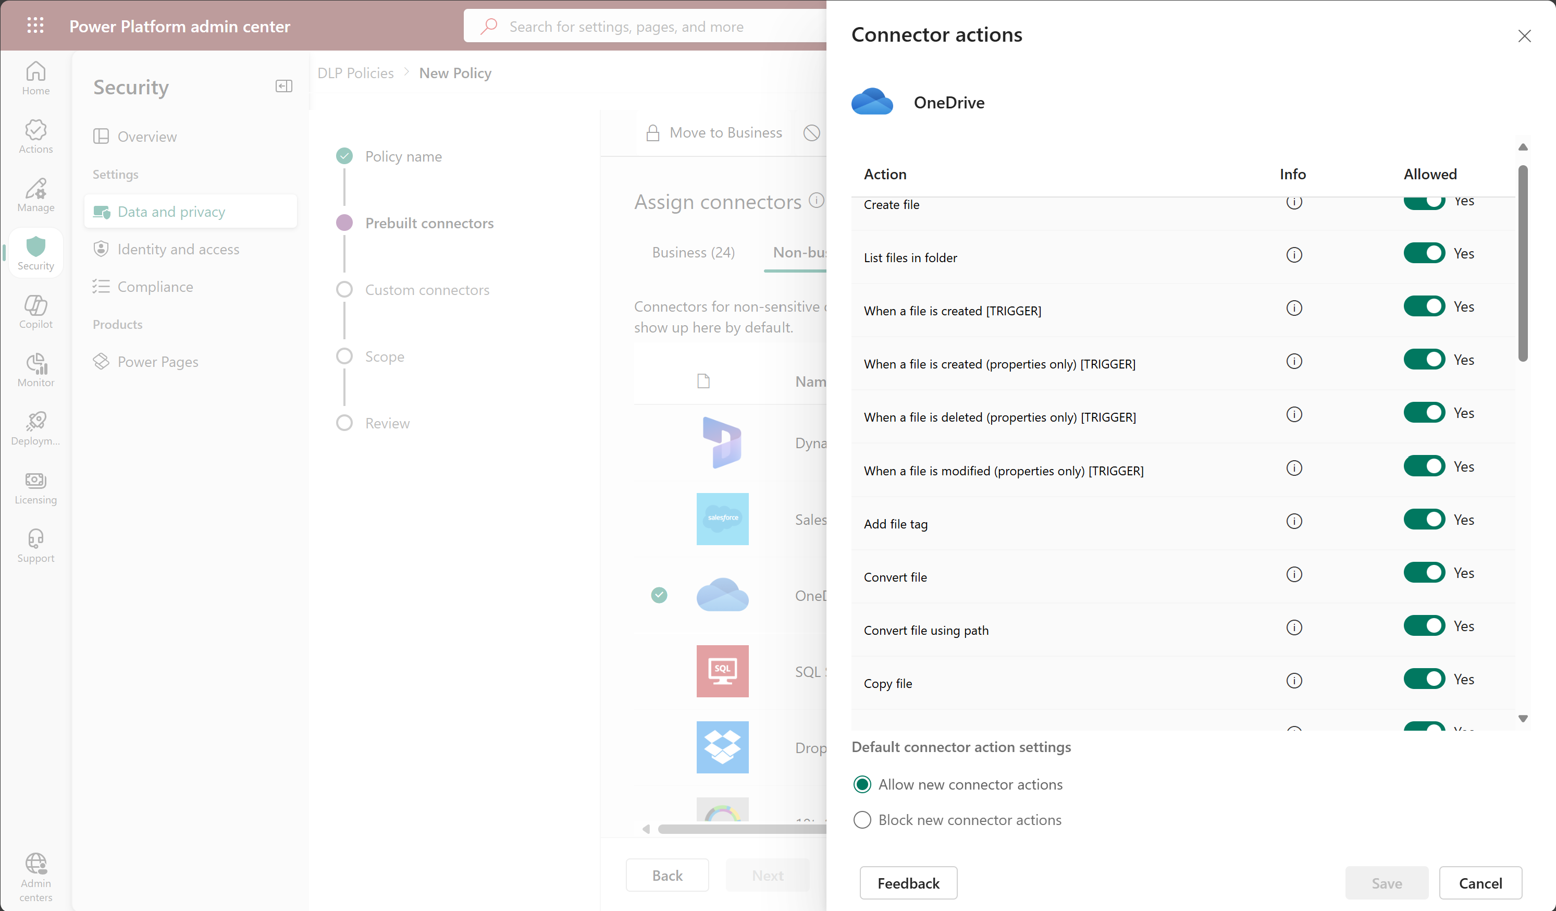
Data Protection – Data Policies: Granular Connector Setup
Access Data and privacy settings
1
Select a connector that can be blokect
2
Granular setup of Connector Actions
3
Allow/Block new connector actions
4

Slide 40
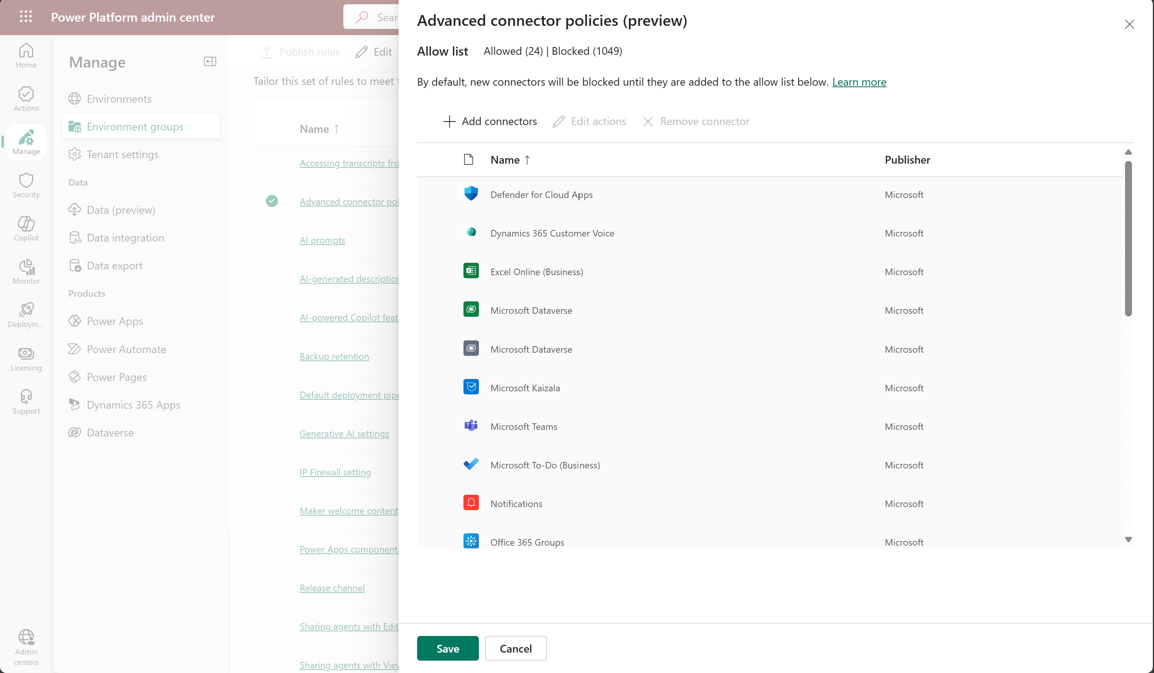
Data Protection – Data Policies: Advanced Connector Policies
Apply connector policies at scale within Environment Groups
Advanced Connector Policies
2
Access Environment Groups
Add new connectors to the list of allowed ones
3
1

Slide 41




Data Protection – Visibility into User & Application Activity
User access and activity (records changes)
Monitor system jobs
Audit deleted jobs
Manage log records
Dataverse, Power Apps, Power Automate, Connectors, Data Activity
Internal and external audit
Audit changes to records and user access
Activities performed on Environments by the Power Platform Administrator
Lifecycle operations, property and setting change activities, security and permission change activities
Dataverse Audit
Activity Logging
Admin Activity Logging
Capture, record, discover and retain your organization's unified audit log
Everything is audited in th PP!
Microsoft Purview Audit

Slide 42
Demo #5: Data Protection & Increase Visibility
Notes:
Data Policies Setup
Dataverse Audit
Purview Audit

Slide 43
Data Protection + Increase Visibility: Key Learnings
Manage @scale with proper environment strategy and corresponding data exfiltration prevention policies & ALM
Leverage analytics, audit and threat detection solutions to get deep visibility into activity on the platform

Slide 44


Data Protection + Compliance
Encryption - last and strongest line of defense in a multi-layered data security strategy
Available out of the box for all data/storage types
Self-manage the encryption key
Prevent access to customer content when you revoke the key access to our services, at any time
Private link
Azure managed-HSM
Automatic key rotation
Protects user from interception of their communication and helps ensure transaction integrity
Protects from bulk interception of data
Protects from interception or loss of data in transit between users
Microsoft Managed Key
Customer Managed Key
Protection for data in transit

Slide 45


Data Protection + Compliance
Time bound access from secured station by personnel with security clearance
Multiple layers of approval
Audit
Extends JIT with customer approval
Bound to specific environment, user and duration
OOB audit available to end user
Tenant home geo default
Multi-geo support (at environment level) to enable global presence
Data resiliency ensured within geo
JIT Access Policies
Customer Lockbox
Data Residency

Slide 46
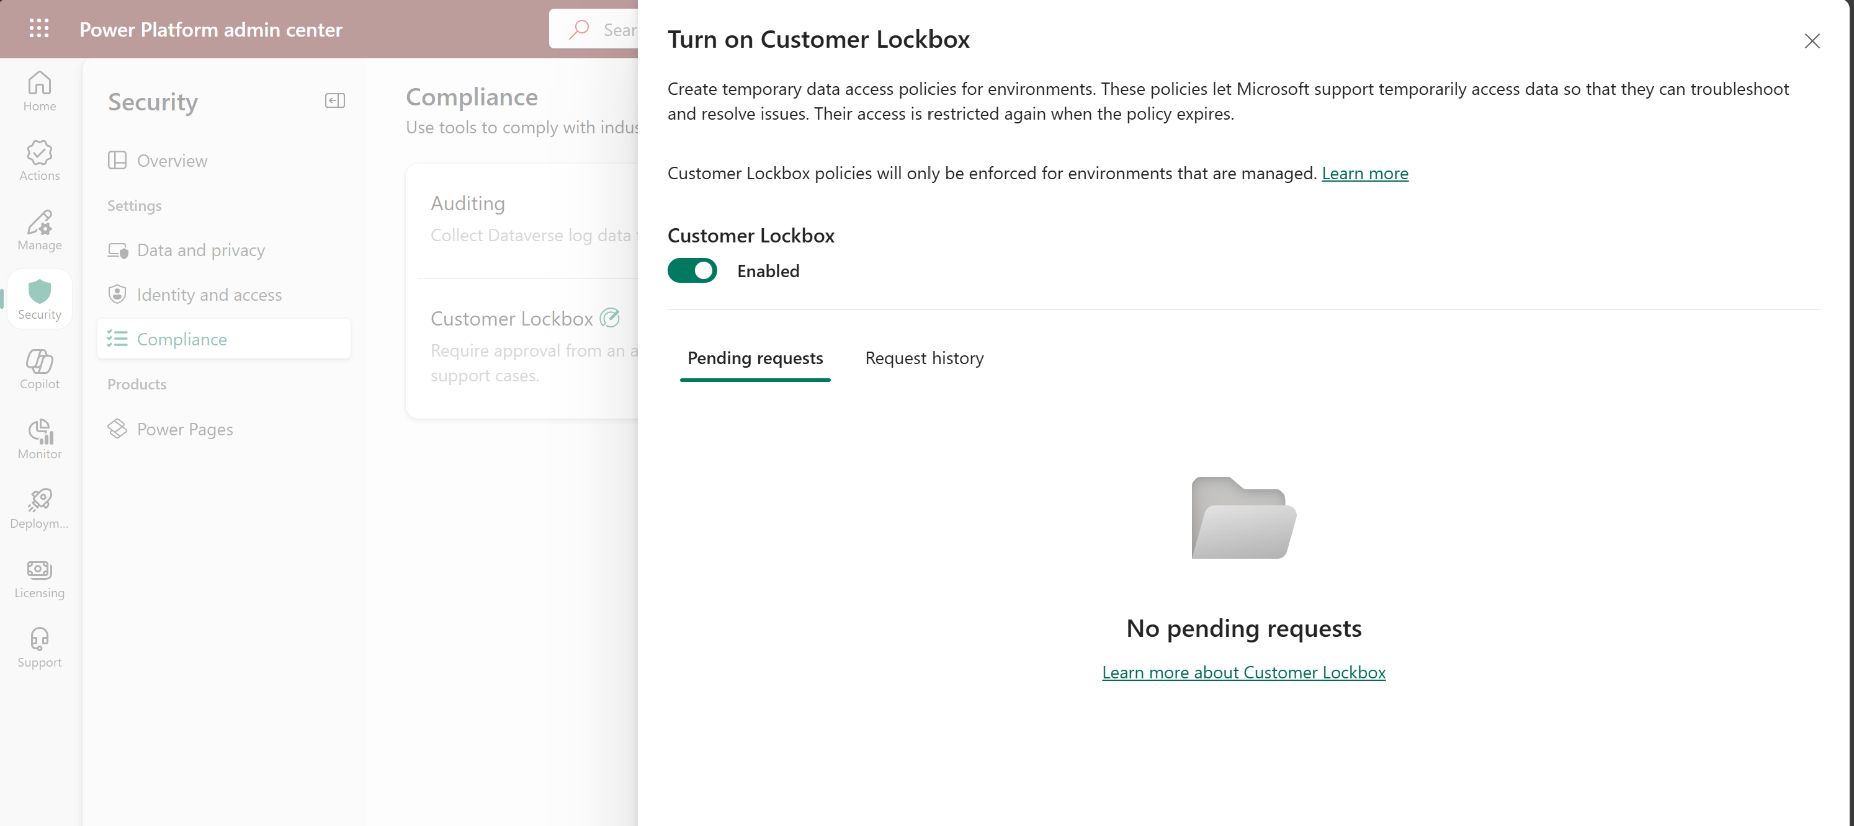
Data Protection + Compliance
Enable/Disable Customer Lockbox
3
Access Compliance settings
Access to Customer Lockbox
2
1

Slide 47
Demo #6: Data Encryption & Compliance
Notes:
Data Policies Setup
Dataverse Audit
Purview Audit

Slide 48
Data Encryption + Compliance : Key Learnings
Use Power Platform Trust Center for latest on security, privacy, compliance, and transparency
Govern Microsoft access to sensitive data with CMK and Lockbox
Govern AI access to sensitive data using Dataverse security controls

Slide 49


Questions?

Slide 50
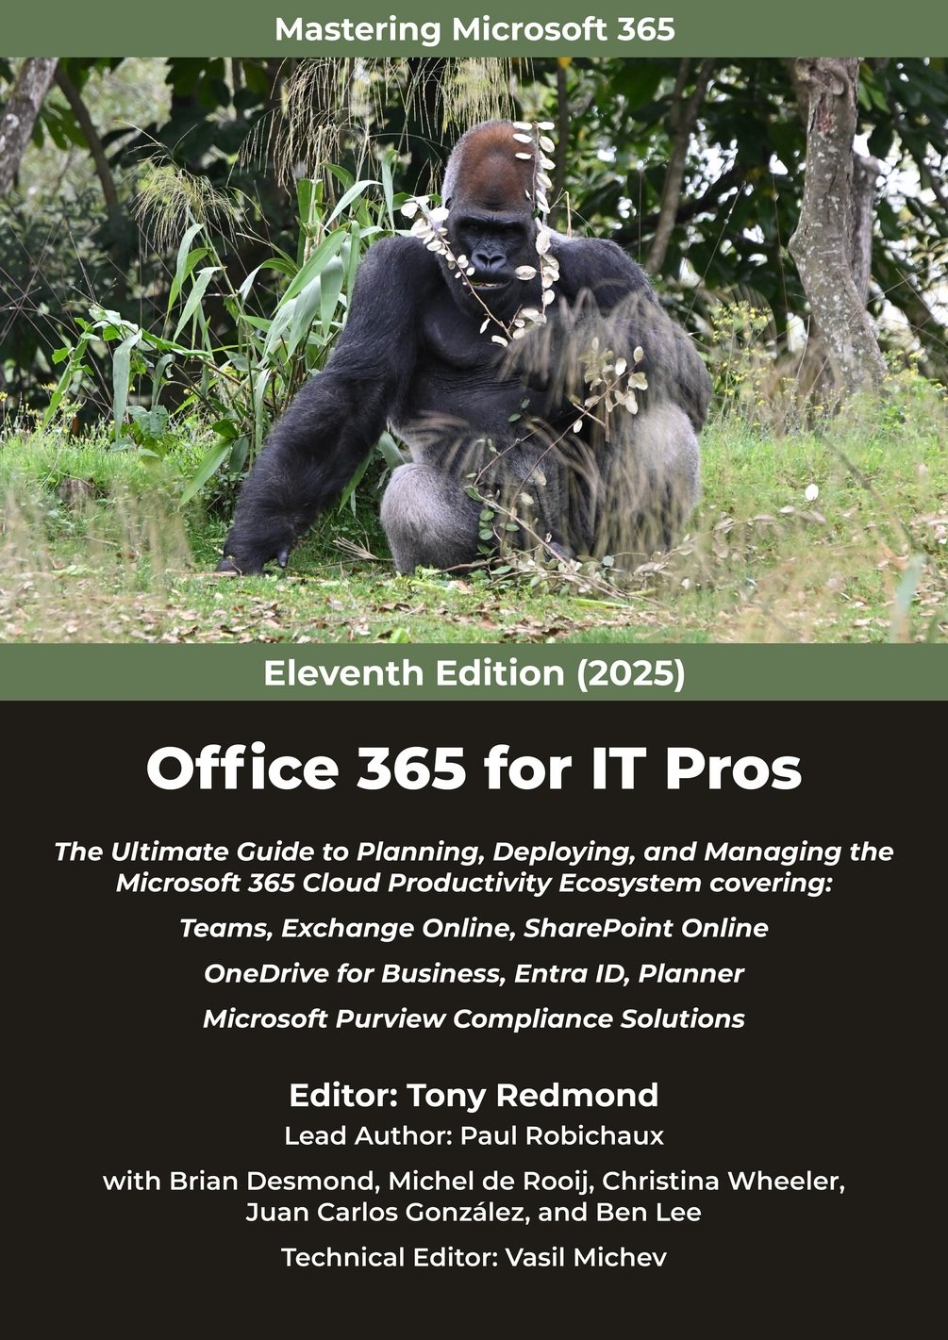
Office 365 for IT Pros
The best way to stay up to date with Microsoft 365 changes:
https://o365itpros.gumroad.com/l/O365IT

